Slide 1
Synopsys Physical Guidance (SPG) Flow SOP
by Louis 2023/2/5

Slide 2
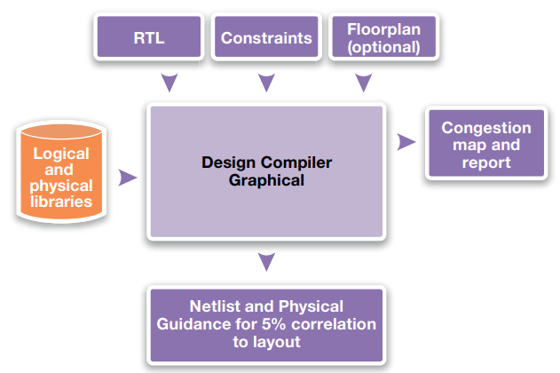
Flowchart

Slide 3
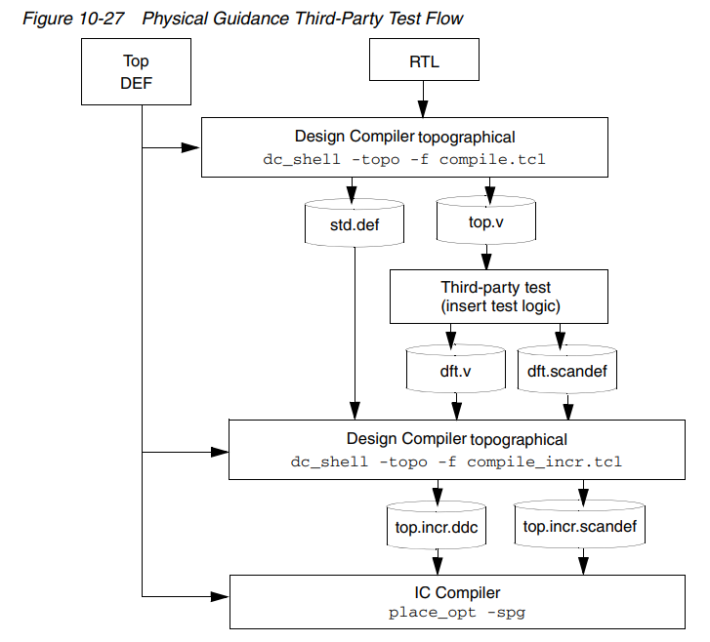
Flowchart in User Guide

Slide 4
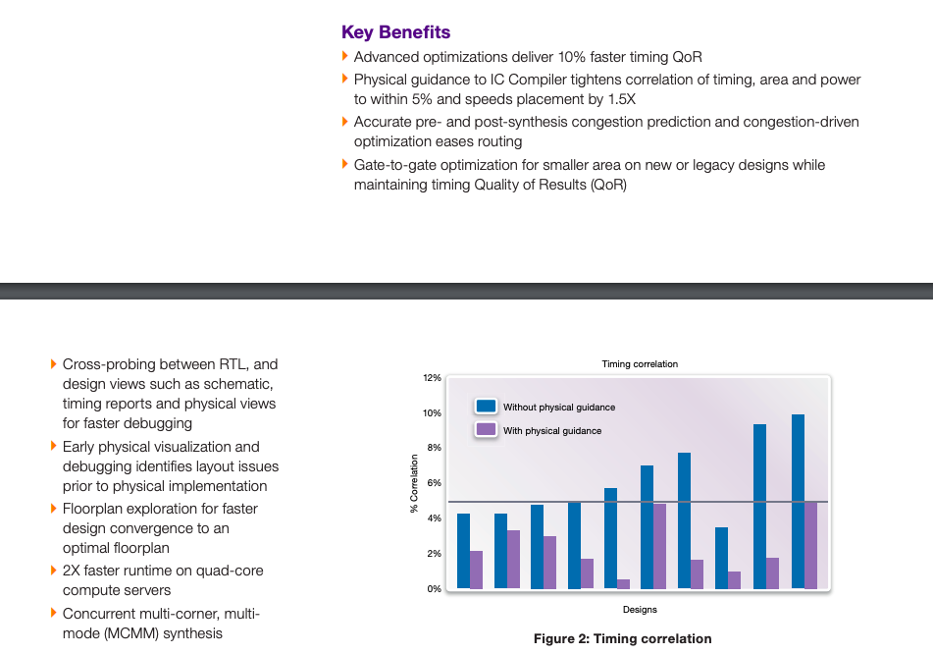
Key Benefits

Slide 5
Step1 : Output .fp & .def in ICC (before placement)
#Finish floorplane & preroute_standard_cells (Before placement)
write_floorplan -create_terminal -row -track -preroute -placement {hard_macro terminal}
\ -pin_guide ${input}.fp
write_def -version 5.8 -rows_tracks_gcells -all_vias -placed -pins –blockages
\ -specialnets -output ${input}.def

Slide 6
Step2 : Read def & fp in DC_NXT topo
#Modified your path and file by yourself
#dcnxt_shell -topo –gui #open it in terminal
set input top
set output after_floorplan_spg
open_mw_lib /home/louis/soc/dff/SGDE
set_app_var link_library "* slow.db fast.db typical.db dw_foundation.sldb"
set_tlu_plus_files -max_tluplus /home/louis/soc/dff/t013s8mg_fsg_typical.tluplus
\-tech2itf_map /home/louis/soc/dff/t013s8mg_fsg.map
read_file -format verilog {/home/louis/soc/dff/SGDE_syn_dft.v}
current_design SGDE
read_floorplan ${input}.fp
extract_physical_constraints ${input}.def

Slide 7
Step3 : Re-syn with SPG
## Use same constraints as synthesis
## You can reference DC synthesis SOP
source ./syn_related/dft_setup.tcl
source ./syn_related/${design}.sdc
source ./syn_related/sta_setup.tcl
source ./syn_related/syn_setup.tcl
compile_ultra -gate_clock -scan –spg
## DFT
set_dft_configuration -fix_reset enable -connect_clock_gating enable
set_dft_clock_gating_pin -pin_name TE [get_cells -hier *clk_gate*]
insert_dft
set_placer_tns_driven_in_incremental_compile true
set spg_congestion_placement_in_incremental_compile true
compile_ultra -gate_clock -scan -spg -incremental

Slide 8
Step4 : Output ddc & def from ICC
## Change name can reference DC synthesis SOP
source ./syn_related/change_name.tcl
write -hierarchy -format ddc -output ${output}.ddc
write_def -output ${output}.def
write_scan_def -output ${output}.scandef

Slide 9
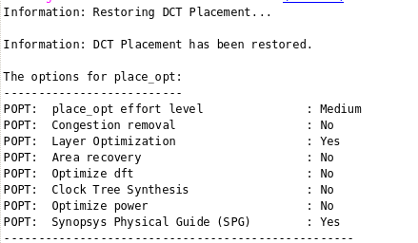
Step5 : Return to ICC & Start from placement
import_designs -format ddc -top SGDE -cel SGDE \{/home/louis/soc/dff/${output}.ddc}
read_def { "/home/louis/soc/dff/${output}.def"}
read_def { "/home/louis/soc/dff/${output}.scandef"}
set placer_disable_auto_bound_for_gated_clock false #for icg optimization
set placer_gated_register_area_multiplier 5
place_opt -power -congestion -area_recovery -optimize_dft -optimize_icgs -spg

Slide 10
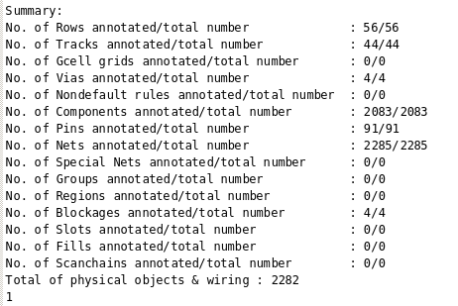
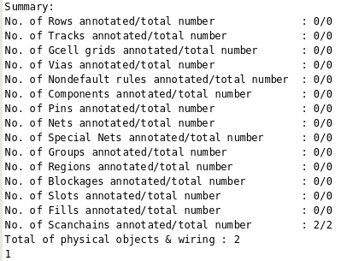
Step5 : Return to ICC & Start from placement
read_def { "/home/louis/soc/dff/${output}.scandef"}
read_def { "/home/louis/soc/dff/${output}.def"}

Slide 11
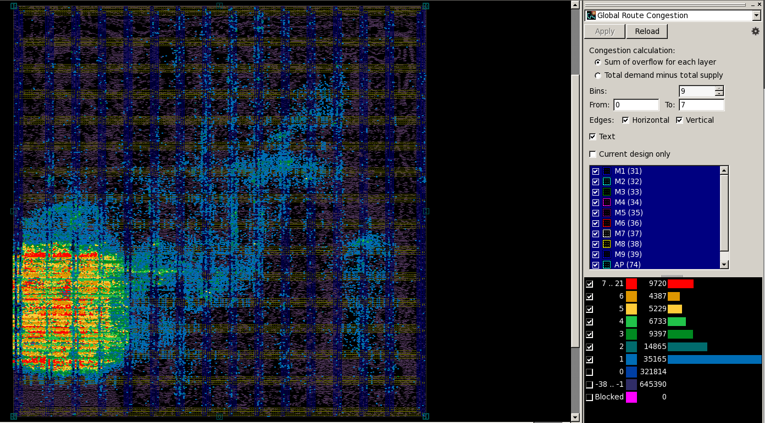
Before SPG, floorplan, core utilization 0.75
Ref from Arthur 20230117 GM

Slide 12
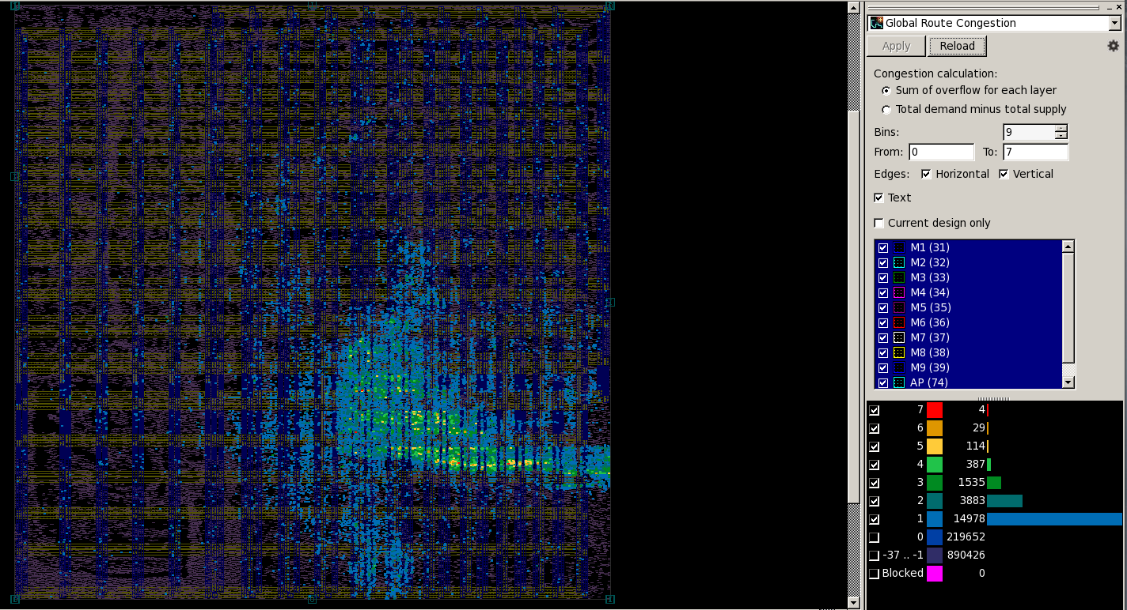
After SPG, floorplan, core utilization 0.75

Slide 13
Good Luck

